Slide 1
3. D|A|CH Symposium 30. – 31.05.2022
eSource – Begriffserläuterung und regulatorische Anforderungen
Gabriele Schwarz
Head of GCP Inspections Unit

Slide 2
Table of Contents
ICH GCP Principles & Glossary
Electronic Source (=eSource) Categories
Trial Participant-Related Source Data
Content & Timelines
Integrity
Verifiability
Investigator Control
Location
EMA Qualification Opinion eSource
eGuidance
Further Readings

Slide 3
1. ICH GCP Principles & Glossary

Slide 4
ICH GCP Principles Clinical Trial Information
2.10 Principle - Clinical Trial Information
All clinical trial information should be recorded, handled, and stored in a way that allows its accurate reporting, interpretation and verification.
ADDENDUM
This principle applies to all records referenced in this guideline, irrespective of the type of media used.

Slide 5
ICH GCP Glossary
1.51 Source Data
All information in original records and certified copies of original records of clinical findings, observations, or other activities in a clinical trial necessary for the reconstruction and evaluation of the trial. Source data are contained in source documents (original records or certified copies).
1.52 Source Documents
Original documents, data and records (e.g. hospital records, clinical and office charts, laboratory notes, memoranda, subjects' diaries or evaluation checklists, pharmacy dispensing records, recorded data from automated instruments, copies or transcriptions certified after verification as being accurate copies, microfiches, photographic negatives, microfilm or magnetic media, x-rays, subject files, and records kept at the pharmacy, at the laboratories and at medico-technical departments involved in the clinical trial).

Slide 6
2. eSource Categories

Slide 7
eSource Categories
The four eSource categories defined by the TransCelerate eSource Initiative are:
EHR/EMR (Electronic Health Records/Electronic Medical Records): Covers collection of clinical data for use in clinical research from site/patient electronic health record systems.
Devices & Apps: Covers collection and management of clinical data from non-site personnel (e.g.: subjects, participants, and caregivers) using mobile devices including smartphone or tablet applications (e.g.: electronic clinical outcome assessment), wearables, and sensors (e.g.: glucose monitor, smart pill, remote chemistry, ambient sensors).
Direct Data Capture (DDC): Includes direct entry of clinical data by site staff into a mobile application or EDC system.
Non-CRFs: Includes collection and transfer of data in electronic format from internal sponsor sources (e.g.: specialty laboratories) or external vendors (e.g.: laboratory results, imaging, ECG, randomization, drug accountability) into clinical research data repositories/warehouses without entering the data onto a Case Report Form (CRF).
TransCelerate - Esource - Clinical Trials (transceleratebiopharmainc.com)

Slide 8
3. Trial Participant Related Source Data

Slide 9
Trial Participant-Related Source Data Content & Integrity (1)
4.9.0 Records and Reports
The investigator/institution should maintain adequate and accurate source documents and trial records that include all pertinent observations on each of the site’s trial subjects.

Slide 10
Trial Participant-Related Source Data Content & Integrity (2)
4.9.0 Records and Reports
The investigator/institution should maintain adequate and accurate source documents and trial records that include all pertinent observations on each of the site’s trial subjects.
What is meant by „all pertinent observations on each of the site’s trial subjects”?
In particular, but not limited to (as far as applicable):
relevant documentation relating to the trial participant’s (subject’s) medical history and ongoing treatment
relevant documentation on concomitant therapies, incl. those from co-treating physicians
information about (serious) adverse events, incl. hospitalization or death
diagnostic outcomes, incl. laboratory results, ECG, ultrasound, images (X-ray, CT, MRI etc.)
copies of central lab data, central imaging, central ECG, central cytogenetic analyses etc. as well as copies of subjects’ ePRO

Slide 11
Subject-Related Source Data Content & Integrity (3)
4.9.0 Records and Reports
The investigator/institution should maintain adequate and accurate source documents and trial records that include all pertinent observations on each of the site’s trial subjects.
§ 630 f Bürgerliches Gesetzbuch (BGB) - Dokumentation der Behandlung
Der Behandelnde ist verpflichtet
zum Zweck der Dokumentation in unmittelbarem zeitlichen Zusammenhang mit der Behandlung eine Patientenakte in Papierform oder elektronisch zu führen. […]
in der Patientenakte sämtliche aus fachlicher Sicht für die derzeitige und künftige Behandlung wesentlichen Maßnahmen und deren Ergebnisse aufzuzeichnen, insbesondere die Anamnese, Diagnosen, Untersuchungen, Untersuchungsergebnisse, Befunde, Therapien und ihre Wirkungen, Eingriffe und ihre Wirkungen, Einwilligungen und Aufklärungen. Arztbriefe sind in die Patientenakte aufzunehmen.
Notes:
BGB Deutsche Gesetzgebung

Slide 12
Trial Participant-Related Source Data ALCOA+
4.9.0 Records and Reports
[…]
Source data should be
attributable: zuordenbar zum Prüfungsteilnehmer; enthalten somit Patienten-Identifizierungsmerkmale wie vollständigen Namen, Geburtsdatum usw.
legible: lesbar
contemporaneous: Erfassung der Quelldaten in zeitnahem Zusammenhang zur Behandlung
original: Original (Erstdokumentation!) oder zertifizierte Kopie (gleiche Informationen wie das [elektronische] Original, alle relevanten Informationen zum Kontext und zur Struktur des [elektronischen] Originals = Metadaten)
accurate: zutreffend und exakt
complete: vollständig in Bezug auf die zu erfassenden Daten per Protokoll, ebenso wie in Bezug zu gemachten Beobachtungen und Maßnahmen

Slide 13
Trial Participant-Related Source Data Traceability
4.9.0 Records and Reports
[…]
Changes to source data should be traceable, should not obscure the original entry, and should be explained if necessary (e.g. via an audit trail).
§ 630f BGB - Dokumentation der Behandlung
(1) Berichtigungen und Änderungen von Eintragungen in der Patientenakte sind nur zulässig, wenn neben dem ursprünglichen Inhalt erkennbar bleibt, wann sie vorgenommen worden sind. Dies ist auch für elektronisch geführte Patientenakten sicherzustellen. […]
§ 10 (Muster-)Berufsordnung für die in Deutschland tätigen Ärztinnen und Ärzte - Dokumentationspflicht
(5) Aufzeichnungen auf elektronischen Datenträgern oder anderen Speichermedien bedürfen besonderer Sicherungs- und Schutzmaßnahmen, um deren Veränderung, Vernichtung oder unrechtmäßige Verwendung zu verhindern. […]

Slide 14
Trial Participant-Related Source Data Verifiability
5.18.4 Monitor's Responsibilities
(m) Checking the accuracy and completeness of the CRF entries, source documents and other trial-related records against each other […]
4.9.2 Records and Reports
Data reported on the CRF, that are derived from source documents, should be consistent with the source documents or the discrepancies should be explained.
6.4.9 Clinical Trial Protocol – Trial Design
6.4.9 The identification of any data to be recorded directly on the CRFs (i.e., no prior written or electronic record of data), and to be considered to be source data.
(e)CRF Daten sollten grundsätzlich auf separaten Quelldaten beruhen und einen gegenseitigen Abgleich ermöglichen; Direkteinträge ins (e)CRF ohne separate Quelldaten = Ausnahme; daher im Prüfplan detailliert darzustellen.

Slide 15
Trial Participant-Related Source Data Direct Access
4.8.10
Both the informed consent discussion and the written informed consent form and any other written information to be provided to subjects should include explanations of the following:
[…]
That the monitor(s), the auditor(s), the IRB/IEC, and the regulatory authority(ies) will be granted direct access to the subject's original medical records for verification of clinical trial procedures and/or data, without violating the confidentiality of the subject, to the extent permitted by the applicable laws and regulations and that, by signing a written informed consent form, the subject or the subject's legally acceptable representative is authorizing such access…

Slide 16
Trial Participant-Related Source Data Investigator Control
8.1 Essential documents for the conduct of a clinical trial/Introduction/Addendum
8.1 The investigator/institution should have control of all essential documents and records (these include source documents/source data) generated by the investigator/institution before, during, and after the trial.
4. Investigator
Addendum
4.2.6 If the investigator/institution retains the services of any individual or party to perform trial-related duties and functions, the investigator/institution should ensure this individual, or party is qualified to perform those trial-related duties and functions and should implement procedures to ensure the integrity of the trial-related duties and functions performed and any data generated.
Comprises services for hosting or archiving of (e)source data/documents

Slide 17
Trial Participant-Related Source Data Location
Addendum to ICH GCP 8.1: The sponsor and investigator/institution should maintain a record of the location(s) of their respective essential documents including source documents.
Der Prüfer / die Prüfinstitution und der Sponsor müssen zu jedem Zeitpunkt wissen, wo sich die Quelldaten befinden.

Slide 18
4. EMA Qualification Opinion On eSource Generated By DDC

Slide 19
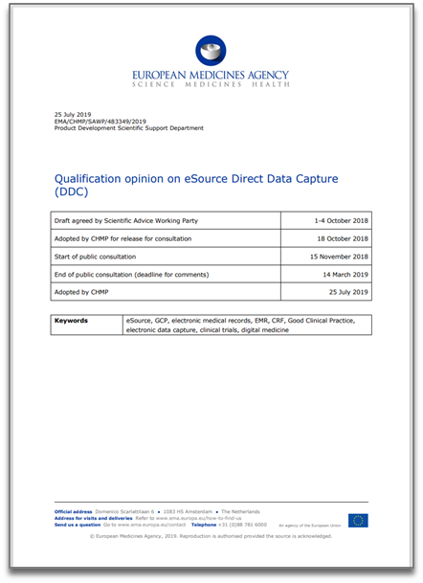
Opinion on eSource DDC Background Information
EMA Scientific Advice sought by Novartis on use of eSource DDC in clinical trials conducted to support a Marketing Authorization Application (MAA)
eSource DDC: any electronic application and/or device that enables direct entry of source data and to directly identify some of these data as CRF data, for clinical trial purposes at the point of care by investigator site staff, for example through an electronic tablet
The proposed eSource DDC concept implies that source data is primarily no longer captured in the document management system of the investigator/institution
Opinion based only on proposal submitted by applicant and not on other solutions and settings, such as direct data input from mobile telephones
https://www.ema.europa.eu/en/documents/regulatory-procedural-guideline/qualification-opinion-esource-direct-data-capture-ddc_en.pdf

Slide 20
Opinion on eSource DDC Presumed Benefits of eSource DDC
Elimination of manual transcription from paper-based source data to EDCs (e.g. eCRF) and medical records resulting in decreased workload for investigators/institutions and avoidance of transcription errors, i.e. increased data quality
The proposed eSource DDC tool enables investigators/institutions to print certified copies of their eSource for paper filing or to upload an electronic certified copy of the source into an electronic medical record (EMR)
Increased potential for centralized monitoring
A more targeted on-site monitoring approach

Slide 21
Requirements for Use of an eSource DDC (1/6) Investigator Site Impact
eSource systems should be sufficiently user friendly to avoid the need for too much training of the investigator site staff, especially in view of the potential emergence of multiple eSource systems
An increased workload for the investigator site staff’s must be avoided
eSource systems should not negatively impact on the interaction between the investigator and the patient, e.g. by ensuring that the use of an eSource tool is not limited to capture data only but enabling capturing of free text as well
Clinical information should be recorded in line with the current practice at the investigator site
Collected information and data is to be mirrored in the patients’ medical records to minimize a duplicated collection effort and documentation as well as to avoid divergent information and data in both places

Slide 22
Requirements for Use of an eSource DDC (2/6) Quality Management
eSource DDC systems should be customized in line with legal requirements (e.g. General Data Protection Regulation (GDPR)) and ICH E6 as well as validated, tested for user acceptability, secure and properly maintained
Benefit/risk evaluation to identify negative impact on quality, traceability and accountability of data collected mainly for the purpose of the clinical trial and for data that will also be a regular part of the medical record of the patient
The system may be the original point of recording specified information, if such direct data entry is specified in the protocol
The system must not impoverish clinical care by depleting the medical records or limiting the capability to record, maintain and trace non-protocol-mandated information (in terms of completeness of data and ease of accessibility)

Slide 23
Requirements for Use of an eSource DDC (3/6) System Qualification & Sponsor Access
The supplier of the eSource system and the sponsor must guarantee to the investigator/institution that this system is GCP compliant. It is the responsibility of the sponsor to ensure that the validation takes place, including trial-specific validation
User rights need to be defined, managed and documented, during the trial and after completion
The sponsor and the system provider must not have remote access to patient-identifying data
An investigator site qualification procedure should be conducted before deploying the system in any given site

Slide 24
Requirements for Use of an eSource DDC (4/6) Data Transfer Between eSource DDC & EMR
Ideally, the system should allow automatic (real-time) transfer of the captured eSource DDC data to the respective sections of the EMR management systems
Trial data needs to be pseudonymized prior to transfer from the investigator/institution to the sponsor, and the investigator site will need to be the sole holder of the link to the records
Traceability and rigorous quality assurance and quality control should be ensured by the sponsor for these data transfers (pseudonymized in eSource and non-pseudonymized in EMR)
All data transfer must be encrypted by state of the art encryption procedures and source data transferred must be protected from alteration, access and duplication in transfer

Slide 25
Requirements for Use of an eSource DDC (5/6) Data Accessibility
Only protocol-mandated source data should be transferred and accessible to the sponsor
Continuous accessibility and control of the eSource data by the investigator/institution during and after completion of the study needs to be guaranteed
System access should be fully audit-trailed. Any eSource DDC tool should include an audit trail per field to trace all changes to data, including those resulting from automated data entry checks
Certified copies of eSource data in form of a printout or pdf flat only acceptable, if eSource only contains elements which can be adequately mirrored in a printout or pdf flat file

Slide 26
Requirements for Use of an eSource DDC (6/6) Long-term Data Custody and Retention
It should be ensured that
data is sufficiently safeguarded from calamities (e.g. bankruptcy and data center calamities).
data is available for inspection at all times. This access should be controlled by the investigator and independent of the sponsor.
it is documented how data availability, accessibility and readability will be guaranteed, in accordance with all applicable laws and guidelines.
back-up and restore processes are in place as well as migration of data and media should be planned, performed and traceable.
it is clearly described (contracts, SOPs, manuals, etc.) and documented who has access to the data at what times and how (password-protected, administrator rights, writing rights, read-only rights, etc.).
eSource data is readable during its entire lifecycle/required retention time (independent from specific software platforms and operating systems).

Slide 27
Opinion on eSource DDC Compliance with ICH E6 and Usability for an MAA
eSource DDC is compliant with ICH E6, if the eSource DDC system is designed to meet all requirements for source data and legal requirements regarding medical records as well as applicable data protection legislation
In case the eSource DDC system has been used in the conduct of a clinical trial, this data can be submitted to support an MAA provided that it is sufficiently GCP compliant, i.e. all requirements mentioned in the Qualification opinion are fulfilled and is available for inspection.

Slide 28
5. eSource Data from Devices & Apps and eNon-CRF-Data

Slide 29
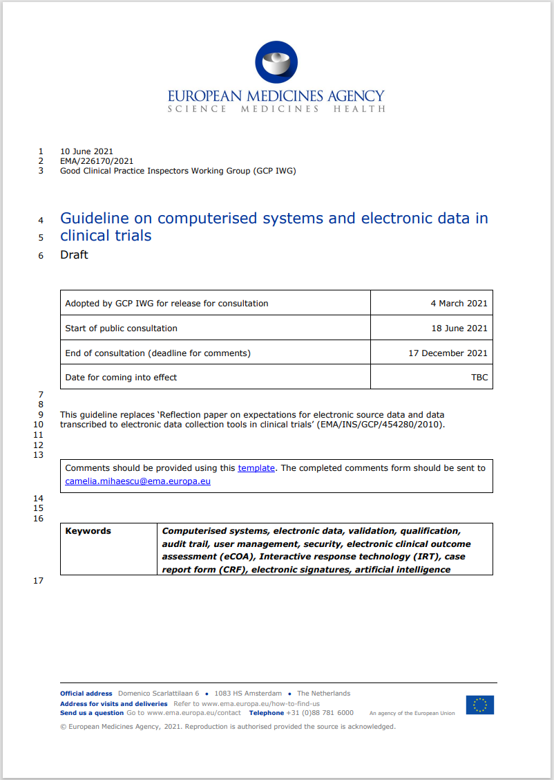
eGuidance Ongoing evaluation and consideration on eSource data
What constitutes an eSource is currently controversially debated. Viewpoints expressed by stakeholders were…
that the first obtainable permanent record (e.g. central server) is source,
that data hold on peripherals are not source,
that data can be processed prior to be source,
that the term “raw data” is used.
The electronic system guideline will address a.o. regulatory considerations on eSource data collection and maintenance. The term “raw data” is not used in the draft guideline…
https://www.ema.europa.eu/en/documents/regulatory-procedural-guideline/draft-guideline-computerised-systems-electronic-data-clinical-trials_en.pdf

Slide 30
eGuidance Wearables & Sensors: From Signal to Source – (pre)processing
The first output of an automatic data processing system is a data record in a machine-readable format (‘data stream’). This format is often not readable for the users without specialized knowledge or tools.
An example, an Electrocardiogram (ECG) consists of thousands over thousands of data points; in this case not each data point, but the ECG itself would be the source.
Should the data stream itself being captured?
Direct access to the data stream often requires manipulation of the device, firmware or other components, which in turn jeopardises the validation of the overall system. General recommendation is that the data stream should not be accessed or stored but only the first human-readable source.
To be considered GCP-compliant source presupposes,
that all previous processing has been adequately validated,
that all processing is adequately described,
that no unintentional or unauthorised interference is possible.

Slide 31
eGuidance ePRO¹ & eCOA²: Manual Data Collection
Manual DDC is common, especially by trial participants. Manual data collection in electronic system has additional requirements to consider.
The original entry should remain legible. It cannot be changed or replaced in the context of abstraction, as in automated data capture, without preserving the original entry.
An example; a questionnaire is filled in and a sum-score is calculated. It would be inappropriate to maintain only the sum-score as source.
The entry should remain assessable and viewable in its original context.
An example; the data is entered in a form. The representation of the form should remain available and cannot be replaced by a line listing.
¹ electronic Patient Reported Outcome
² electronic Clinical Outcome Assessment

Slide 32
eGuidance How to maintain eSource on peripheral devices?
Data are generated mostly on peripheral devices such as wearables or smart devices. Data and context are the source.
Data and context are usually stored in volatile memory first and than transferred to nonvolatile memory (local or central). Volatile means: The data will be lost, if the power of the memory is disconnected!
Local non-volatile memory is still vulnerable. Therefore, the source should not remain on peripherals (e.g. fit bit, eDiary).
The transfer of source data with simultaneous erasure at the origin, requires that the result of the transfer corresponds to a certified copy; see ICH E6(R2) 1.63. The transfer itself should be recorded accordingly as part of the audit trail or an event log.

Slide 33
5. Further Readings

Slide 34
Further Readings
Guideline for Good Clinical Practice E6(R2)
EMA Reflection paper on expectations for eSource data and data transcribed to electronic data collection tools in clinical trials
FDA Guidance for Industry - Use of Electronic Health Record Data in Clinical Investigations
Q&A document on the level of validation/qualification needed to be performed by a sponsor when using an electronic system previously qualified by a provider and the documentation required to be available for inspection
http://www.ema.europa.eu/ema/index.jsp?curl=pages/regulation/q_and_a/q_and_a_detail_000016.jsp&mid=WC0b01ac05800296c5
EMA-Guideline on computerized systems and electronic data in clinical trials (EMA/226170/2021) (Draft version for public consultation, adopted March 2021)
https://www.ema.europa.eu/en/documents/regulatory-procedural-guideline/draft-guideline-computerised-systems-electronic-data-clinical-trials_en.pdf

Slide 35
Thank you very much for your attention!
Contact
Federal Institute for Drugs and Medical Devices
GCP Inspections Unit (10.41)
Kurt-Georg-Kiesinger-Allee 3
53175 Bonn
Contact Person
Gabriele Schwarz
Gabriele.Schwarz@bfarm.de

