Slide 1
3. D|A|CH – Symposium 30. – 31.05.2022
Decentralized Clinical Trials (DCT)
Gabriele Schwarz
Head of GCP Inspections Unit

Slide 2
Disclaimer
This presentation reflects primarily the thoughts and opinions of the presenter and does not necessarily represent in all aspects the official position of the BfArM, the EMA or the EC.
Furthermore, please note that this presentation partly shows documents that are in preparation and therefore their content may still change.

Slide 3
1. Challenges in implementing new rules and regulations due to the complexity of the legal framework for clinical trials with medicinal products

Slide 4
European Regulatory Landscape for Pharmaceuticals
Centralized and Decentralized Governance

Slide 5
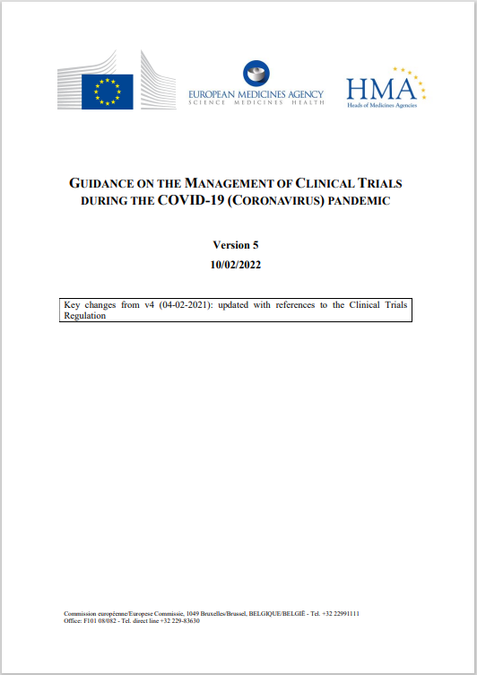
EC/EMA/HMA*
Observed challenges during the pandemic include restrictions on visiting healthcare facilities, travel restrictions, self-isolation of or quarantine for trial participants and/or trial staff and others
Potential mitigation measures include amongst others
changes in the distribution of the investigational medicinal products
alternatives to physical visits such as home nursing, telephone or telemedicine contact
changes to monitoring and auditing
All decisions to adjust clinical trial conduct should be based on a document risk assessment by the sponsor (ICH GCP section 5.0) for each clinical trial and the investigator for each individual trial participant; the risks should be periodically re-reviewed
The guideline loses its applicability with the end of the pandemic...it can be assumed, however, that the experience gained may stimulate further regulatory developments.
*https://ec.europa.eu/health/system/files/2022-02/guidanceclinicaltrials_covid19_en_1.pdf

Slide 6
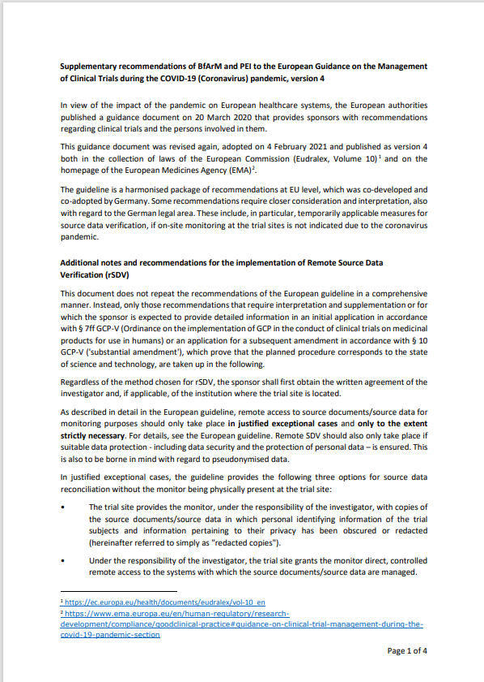
Germany*
Supplementary recommendations of BfArM and PEI to the European Guidance on the Management of Clinical Trials during the COVID-19 (Coronavirus) pandemic, version 4
This document does not repeat the recommendations of the European guideline in a comprehensive manner. Instead, only those recommendations that require interpretation and supplementation or for which the sponsor is expected to provide detailed information in an initial application or an application for a subsequent amendment which prove that the planned procedure corresponds to the state of science and technology, are taken up.
*https://www.bfarm.de/SharedDocs/Downloads/EN/Drugs/licensing/clinicalTrials/Supplementary%20Recommendations%20to%20EU%20Guidance%20on%20the%20Management%20of%20Clinical%20Trials%20during%20the%20COVID-19.pdf;jsessionid=87770F74C8067A2DE94BC3D4F5FCE241.intranet381?__blob=publicationFile

Slide 7
Cooperation Between Regulatory Bodies and Groups in the Context of DCTs
European Commission (EC)
Clinical Trials Expert Group (CTEG)
Working group of the European Commission representing Ethics Committees and National Competent Authorities (NCAs)
CTCG initiated
sub-group which will provide recommendations on DCTs
Clinical Trials Facilitation And Coordination Group (CTCG) Harmonization of principles and clinical trial assessment/authorization decisions across the NCAs
Heads of Medicines Agency (HMA)
GCP Inspectors Working Group
(GCP IWG) Provides expert advice and support to
the EU/EWR-MS, the EC, the EMA and its scientific committees and others on matters related to GCP and GCP inspections
European Medicines Agency (EMA)

Slide 8
Europe*
Recommendation paper still under development
Collaboration between CTEG, CTFG and GCP IWG
Topics currently in debate
Introduction and scope
Definitions
General considerations
Recruitment, Patient Information, eIC
Clinical operation processes
Responsibilities
Safety collection and reporting
Direct to patient drug supplies and management
Data life cycle and quality

Slide 9
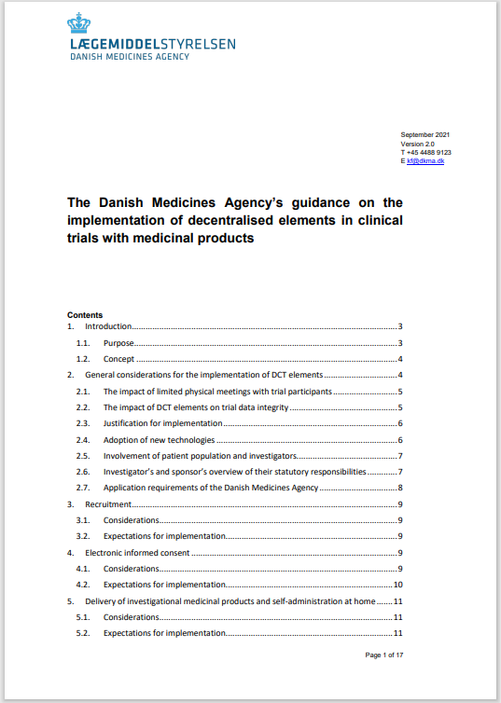
Denmark*
The Guidance from Sep. 2021 addresses the following topics
General considerations
Recruitment
eIC
Delivery of IMP and self-administration at home
Remote monitoring of trial participants’ safety
AE reporting
Choice and validation of endpoints
Remote access to source data
IT systems and electronic collection, handling and storage of data
The guidance underlines that a trial-specific risk assessment shall always be carried out together with justification for the selected decentralized elements, which, in principle, should be part of the protocol.
*https://laegemiddelstyrelsen.dk/en/news/2021/guidance-on-the-implementation-of-decentralised-elements-in-clinical-trials-with-medicinal-products-is-now-available/~/media/5A96356760ED408CBFA9F85784543B53.ashx

Slide 10
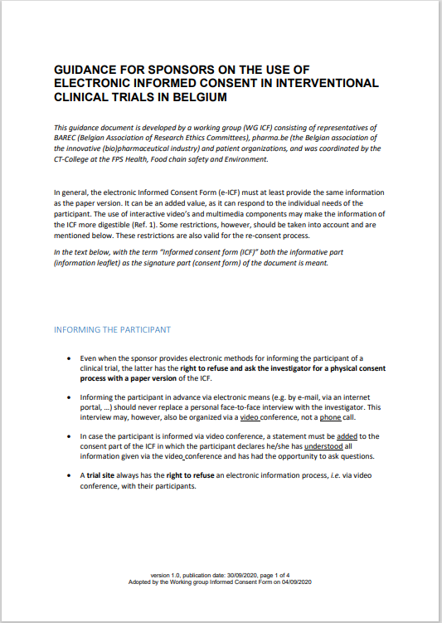
Belgium*
This Guidance from Sep. 2020 was developed by a working group (WG ICF) consisting of representatives of BAREC (Belgian Association of Research Ethics Committees), pharma.be (the Belgian association of the innovative (bio)pharmaceutical industry) and patient organizations, and was coordinated by the CT-College at the Federal Public Service (FPS) Health, Food chain safety and Environment.
The following aspects are addressed in this Guidance:
Informing the participant
Signing the consent form
Access to e-ICF after signing
Submission dossier
GDPR
*https://overlegorganen.gezondheid.belgie.be/sites/default/files/content/guidance_on_use_of_e-icf_vf.pdf

Slide 11
International* ICH E6(R3) Guideline “Good Clinical Practice” (GCP)
Overarching principles that apply across the board
Published in April 2021
Annex-1
Considerations for non-traditional interventional clinical trials
GCP for Interventional clinical trials
Annex-2
Additional considerations for non-traditional interventional clinical trials not addressed in Annex-1
Annex-2
Annex-1
Reflects the concepts in E6(R2) (with updates and refinements as needed)
https://database.ich.org/sites/default/files/E6-R3_FinalConceptPaper_2019_1117.pdf

Slide 12
2. Regulation and Standards for DCT; what needs to be considered?

Slide 13
DCT Toolbox (examples)
D2P IMP & Trial supplies shipment
Health Apps
Local Biosample collection
eConsent
Local HCP Support
Home Nursing
Remote Trial Visits
Mobile Devices and Sensors
Digital Recruitment
ePRO
eCOA
Remote Study
Coordinator

Slide 14
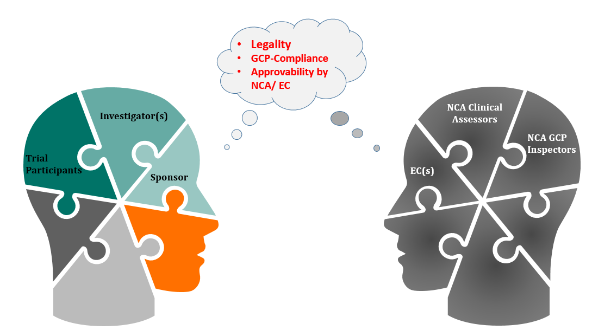
Implementing DCT Elements from the Toolbox in the Trial Design
General Considerations

Slide 15
Example: Electronic Informed Consent Regulation on European Level
REGULATION (EU) No 536/2014
Article 29 Informed consent
Informed consent shall be written, dated and signed by the person performing the interview referred to in point (c) of paragraph 2, and by the subject or, where the subject is not able to give informed consent, his or her legally designated representative after having been duly informed in accordance with paragraph 2
[…]
The information referred to in paragraph 2 shall be prepared in writing and be available to the subject or, where the subject is not able to give informed consent, his or her legally designated representative.
Electronic Informed Consent
LEGALITY:
Can the requirement for a written signature be replaced by an electronic solution and what would be the legal specifications for it?

Slide 16
Example: Electronic Informed Consent National Regulation on the example of Germany (I)
Medicinal Products Act (Arzneimittelgesetz AMG) (implem. CTD 2001/20/EC)
Section 40 General conditions for clinical trials
[…] 3. the person concerned:
[…] b) has been informed pursuant to subsection (2) sentence 1 and has given written consent […]
Electronic Informed Consent
German Civil Code (Bürgerliches Gesetzbuch BGB)
§ 126 => Written form […] (3) Written form may be replaced by electronic form, unless the statute leads to a different conclusion
§ 126 a (1) If electronic form is to replace the written form prescribed by statute, the issuer of the declaration must add his name to it and provide the electronic document with a qualified electronic signature in accordance with the Electronic Signature Act [Signaturgesetz] => superseded by Regulation (EU) No 910/2014
Notes:
Note:
Ergänzung: „as of 26th Jan 2022“, da 2 parallel gültige AMG-Versionen:
1. AMG Fassung bis 26 Jan. 2022
2. AMG: Gesetz über den Verkehr mit Arzneimitteln (Arzneimittelgesetz - AMG) § 148 Übergangsvorschrift aus Anlass des Vierten Gesetzes zur Änderung arzneimittelrechtlicher und anderer Vorschriften sowie des Gesetzes zum Erlass eines Tierarzneimittelgesetzes und zur Anpassung arzneimittelrechtlicher und anderer Vorschriften
Die Vorschrift, dass IC schriftlich zu unterzeichnen ist, gibt es in der neuen AMG Version nicht mehr, allerdings ein Verweis auf die EU VO 536/2014
Aufgrund der 3-jährigen Übergangsreglung kommen entsprechend der Genehmigung sowohl Directive 2001/20/EC als auch für Neueinreichungen nach CTR 536/2014 zur Anwendung.

Slide 17
Example: Electronic Informed Consent National Regulation on the example of Germany (II)
Regulation (EU) No 910/2014
Article 3 Definitions
[…] (12) ‘qualified electronic signature’ means an advanced electronic signature that is created by a qualified electronic signature creation device, and which is based on a qualified certificate for electronic signatures;
Electronic Informed Consent
Article 26 Requirements for advanced electronic signature
An advanced electronic signature shall meet the following requirements:
(a) it is uniquely linked to the signatory;
(b) it is capable of identifying the signatory;
(c) it is created using electronic signature creation data that the signatory can, with a high level of confidence, use under his sole control; and
(d) it is linked to the data signed therewith in such a way that any subsequent change in the data is detectable.
FEASABILITY?

Slide 18
Thank you very much for your attention!
Contact
Federal Institute for Drugs and Medical Devices
GCP Inspections Unit (10.41)
Kurt-Georg-Kiesinger-Allee 3
D-53175 Bonn
Contact Person
Gabriele Schwarz
Gabriel.Schwarz@bfarm.de

